Slide 1
Laidlaw Leadership and Research Programme
at Newnham College, Murray Edwards College, Fitzwilliam College, and Trinity Hall at the University of Cambridge
Informational Session | October 25^{th,} 2022
Notes:
Presentation given by Laidlaw Administrator: Geneviève Young
Genevieve.young@newn.cam.ac.uk

Slide 2
Session Overview
1. About the Laidlaw Programme
2. Leadership Training
3. Summer Research
4. Leadership-in-Action
5. Laidlaw Scholars
6. Eligibility and Applications

Slide 3
About the Laidlaw Programme
Started at the University of Leeds and University of St. Andrews in 2014
Gift of Lord Laidlaw of Rothiemay and the Laidlaw Foundation
to four participating Cambridge colleges, administrated by Newnham College
25 Scholars per year
16 member institutions worldwide:
*The Swiss Federal Institute of Technology Lausanne (EPFL) to join the programme in 2023. Participating colleges at Cambridge are: Newnham College, Murray Edwards College, Trinity Hall, and Fitzwilliam College.
https://laidlawscholars.network/
Notes:
-has been running for several years, is well established
-participating Cambridge colleges are Fitzwilliam, Newnham, Murray Edwards, Trinity Hall
-25 scholars per cohort per member university
-16 member institutions world-wide – as you can see, the Cambridge-based scholars are joining a really great network *I will refer to the Laidlaw Scholars Network a few times this evening, so just to draw your attention to the URL at the bottom of the slide – the network is both a collection of universities and an incredible web-based resource

Slide 4
The Laidlaw Leadership and Research Programme aims to develop a new generation of leaders who are skilled researchers, embrace data-based decision making, and believe it is a moral imperative to lead with integrity.​

Slide 5
#LaidlawScholars23
@Cambridge!
25th October 2022
Notes:
Slides 5-17 are provided by Laidlaw CEO (and Cambridge alum) Susanna Kempe.

Slide 6
The Laidlaw Foundation invests in the education of the underprivileged and underrepresented in order to break the cycle of poverty, reduce inequality and develop a new generation of leaders.

Slide 7
The Laidlaw Manifesto
Notes:
https://www.youtube.com/watch?v=RSe8DTlokqA

Slide 8
Notes:
As a Foundation, we invest in education because we believe it has the power to transform lives. As well as funding this Scholarship programme, we sponsor 7 schools in the NE of England, all in disadvantaged areas, so I am particularly excited to see all the research around education: Sophie looking at special needs education, Victoria researching autism in second schools, Jakob looking at how to make MATs serving disadvantaged communities succeed and so many more.
When Lord Laidlaw, who you’ll get to ask questions a bit later, began funding the Laidlaw Scholarships, it was because he believed fervently that we need leaders who are good at research, who understand data, who actively search out answers, who believe in evidence based decision making. And who tell the truth. Which frankly you wouldn’t think was such a big ask and yet….

Slide 10
Notes:
The third of our programmes is supporting women from socio-and-economically disadvantaged backgrounds to earn their MBAs at CBS, LBS and Oxford’s Said Business School. LBS is going to launch a programme next year for early admissions aimed specifically at Laidlaw Undergraduate Scholars.

Slide 13
734m live < $1.90 a day
50m children in war zones
9% female Fortune 500 CEOs
Poorest 50% own just 1%
750m illiterate adults
8m air pollution deaths
6 Black Fortune 500 CEOs
Notes:
And there is an awful lot that we need to change.
The poorest 50% of the population have just 1% of the world’s wealth.
734 million people live on less than $1.90 a day (that’s 10 pct of the world’s population).
There are 8 million deaths a year due to air pollution.
50m children live in conflict affected states and are unable to attend school
759 million adults are illiterate
Only 5% of Fortune 500 CEOs are women. There are only 4 Black Fortune 500 CEOs, all men.
And to add insult to injury. We are 18 months on, still in the midst of a pandemic.
Self-evidently, the last year has been tough. Globally, over 3 million people have now died from Covid. The most disadvantaged in society have suffered the most, with poverty rates rising for the first time since 1998. I am sure that your university experience has not been as you imagined.

Slide 14
Notes:
And yet. Looking at the profiles and research outlines of all our incoming Scholars, seeing you all gathered here, and knowing what we achieved together last year, I feel optimistic about the future.
As you know, there are five parts to this programme.
The first is research. Last year, our Scholars produced original, insightful research, despite being locked out of labs and face to face supervision. And I know you will too.
From Joe in Dublin, counting bacteria colonies on contact plates, Hillary from HK researching a compound that targets a cancer related protein, Amena in Leeds studying global capstones, Charlie investigating body dysmorphic traits, Mary uncovering which regions of the brain are used in working memory; Rizwana at Columbia analysing Chinese Trade policy and Tasuku who was born in Japan and is now studying at Leeds, investigating plastic degradation, Mackenna comparing animal shelter policies and metrics –
Every research project that I read about impresses me with its ambition and potential to make the world a better place.

Slide 15
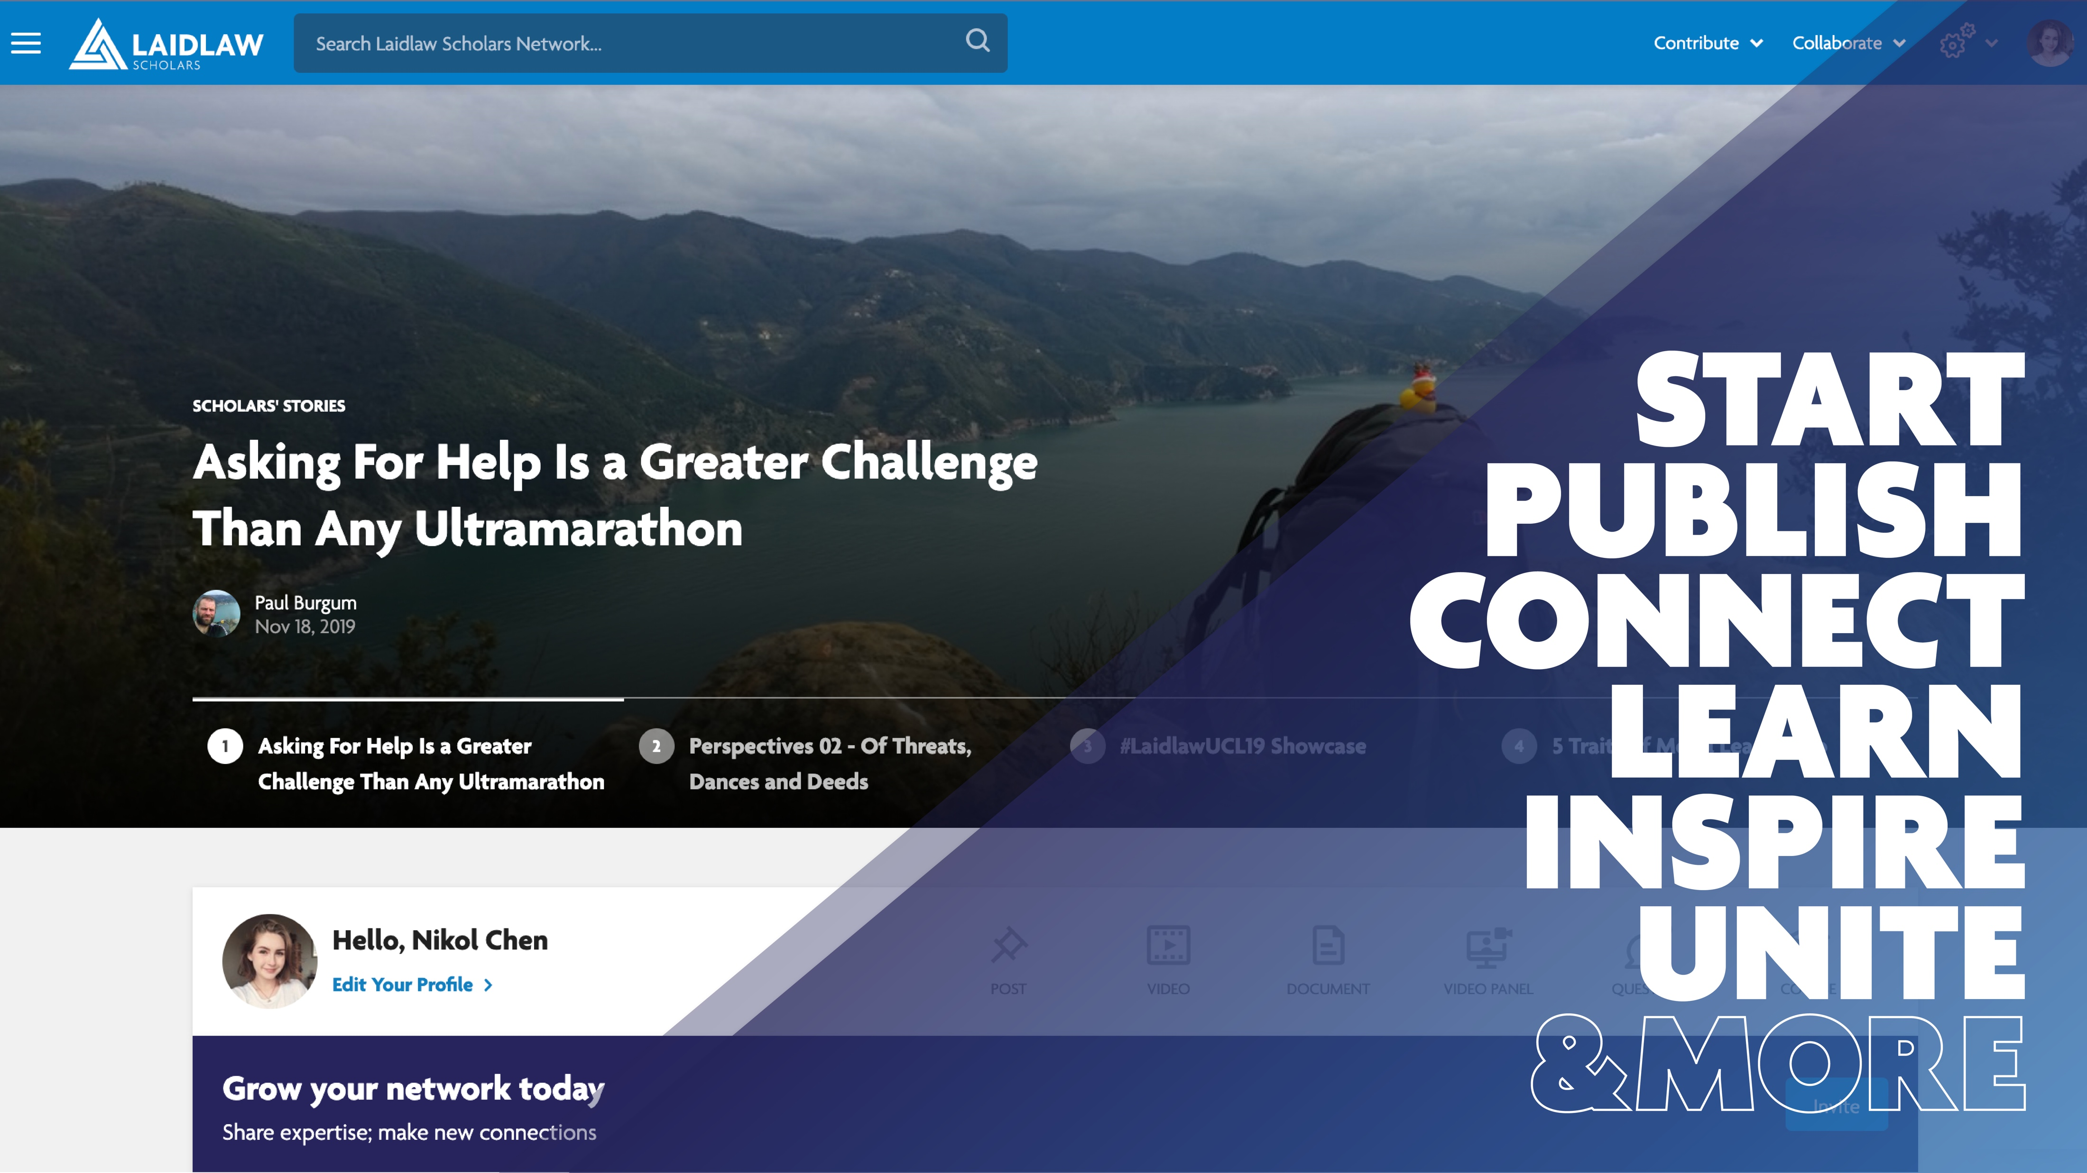
Notes:
It has been fantastic to see the conversation thread on the Laidlaw Scholars Network, the last element of this programme. Thank you to everyone who introduced themselves. You will have seen that it is the optimum place to connect, collaborate, and share your stories and successes. Nikol is going to give you more information about how to get the best out of it shortly.
Collective intelligence and peer to peer learning, is at the heart of the Scholars Network both virtually and in-person. Ariella is going to explain about a new peer initiative started at Columbia and going global this year.
This programme is growing at warp speed so watch out for announcements on the Network about all sorts of new things. There will be global lectures to join, webinars with Extraordinary Leaders coming up (one is being announced tomorrow which I’m really excited about so be sure to check in) and opportunities to benefit from some of the other work that the Foundation does.

Slide 16
Join 1000+ Change Makers

Slide 18
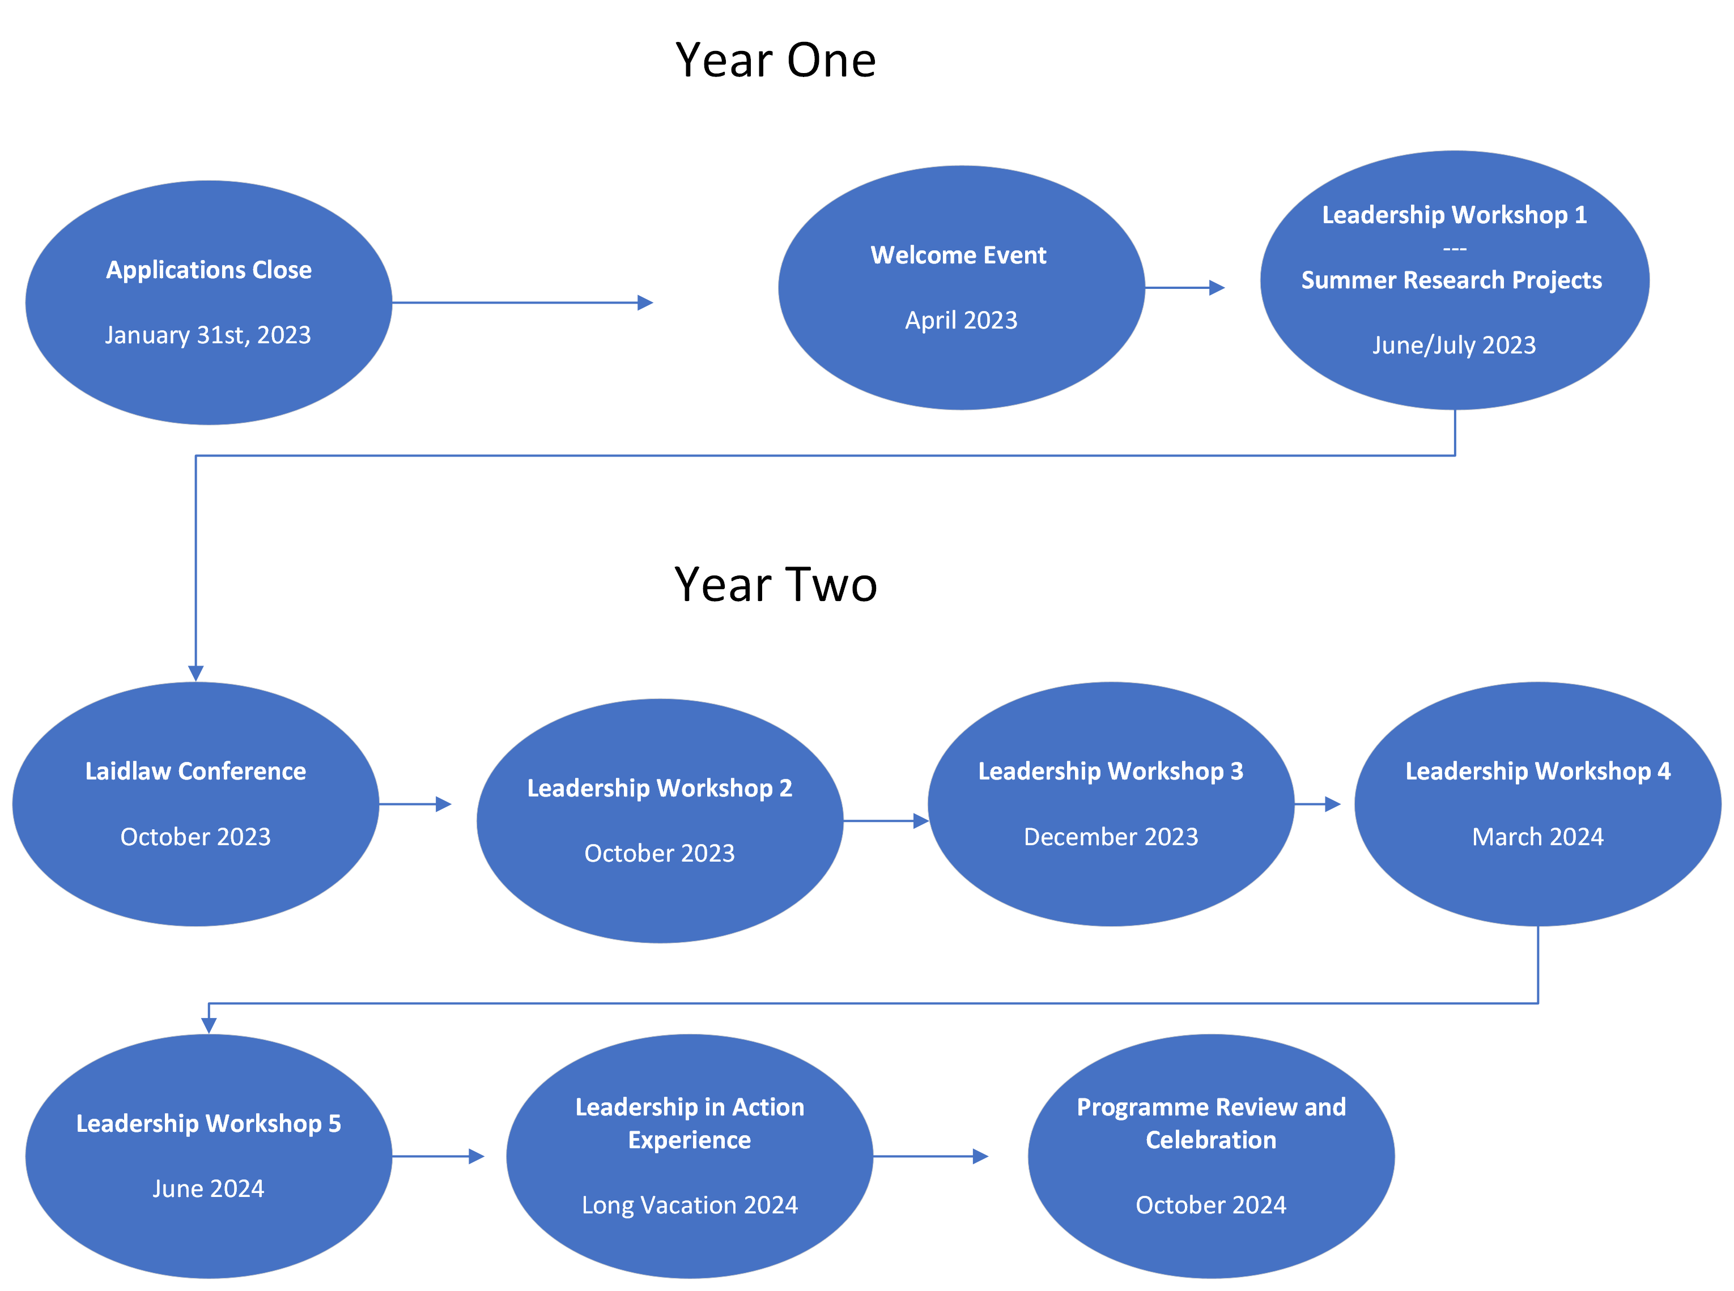
Notes:
- the core programme is a mix of leadership workshops and projects runs for 18 months, including two summers from April 2023 through October 2024
-You can see on the chart Leadership Workshop 1,2 ,etc. : Core leadership programming: equivalent to six days divided into workshops and retreats of varying lengths;
-opportunity to attend the Laidlaw Conference in October, which brings together scholars from member institutions in Europe and the UK (there is also a US-based conference, which accepts a smaller number of delegates from the UK cohorts)
- Not on the chart but taking place throughout the programme are an Ethical Leadership masterclass organized by the London Business School, spaces for coaching and mentorship, and additional opportunities for learning, networking, and socializing organised for you by the participating colleges. You can also take advantage of ongoing mentoring/mentorship after you complete the programme.

Slide 19
Leadership Training
Key Questions:
What does leadership mean to you?
What can leadership look like in different contexts?
Outcomes:
Engage in practical leadership activities. Reflect on your experiences.
Gain deeper self-knowledge. Find your leadership style.
Grow your network and become part of a leadership community.
Create connections between leadership and academics (research).
Notes:
-built around Key themes: understanding yourself, understanding different leadership styles, intercultural awareness, time and project management. And others.
-practice and develop leadership skills that you can take out into the world; reflecting on good leadership, and adapting to different contexts; always with a focus on moral, honest, ethical leadership
-when we talk about different contexts, we mean it: this training is not geared only to business or academia, but rather towards getting you thinking about what leadership is across sectors, in different social environments, regardless of what your future plans are, no matter where you end up (arts, education, business, heritage, research, development, it doesn’t matter, this training will be applicable.
-join the global Laidlaw community, which is a large and extremely valuable network of successful people in a variety of professional, political, Entrepreneurial, and academics fields (and you could be one of them!)
-note that this is a training programme – we don’t expect applicants to already be at the top of their game (so to speak) but rather to be passionate about gaining and developing leadership skills even if those skills are brand new

Slide 20
Summer One: Research Project
6 weeks in the 2023 long vacation
2023 dates are June 17-July29; in Cambridge
Student designed; student led
It's your project – follow your curiosity and your passion
A chance to be creative, be innovative, be interdisciplinary, push at the bounds of your field
Publication and/or presentation of your research in other venues is allowed, encouraged
Work with a Cambridge-based academic
£3000 stipend to cover your room and board, research expenses, etc.
All subjects and academic disciplines are welcome!
Notes:
All Scholars start off with a summer research project of their choosing. You will work with a Cambridge based research supervisor, who can help with the details of your specific project, but you can find examples of past projects on the Laidlaw Scholars Network, and some tips and tricks in the applicant’s guide linked on the laidlaw.fund.cam.ac.uk site
-You should plan to stay in Cambridge during this 6-week period
-your research supervisor does not have to be based at a participating college -- they can be based at any Cambridge faculty or college, or any affiliated institute, library, or museum (such as the Fitzwilliam Museum, or the Botanic Gardens)
-there is a stipend available for your research supervisor, so they can expect to be compensated for their work – Your first step will be to share the website with them, but I do have a document with further guidance for supervisors, so if you are in touch with a proposed supervisor who is interested but wants more information, you can put them in touch with me and I can provide this to them.
-you will share your project via the Laidlaw Scholars Network, have opportunities to present at the Laidlaw Conference and here in Cambridge (presentation in other venues is encouraged, if you so choose)

Slide 21
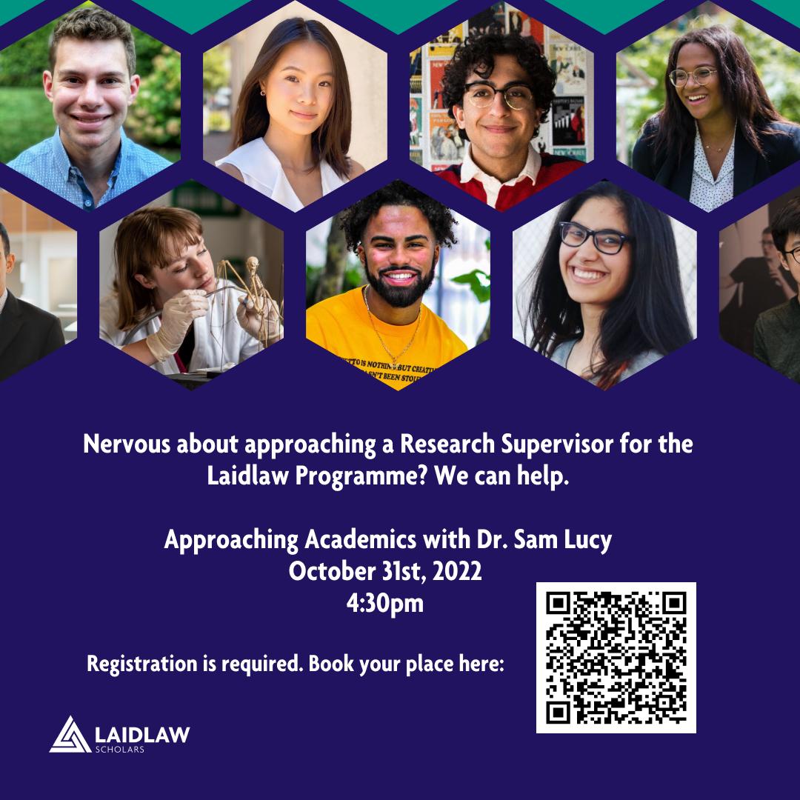
Notes:
You are responsible for finding your own research supervisor:
-we know this might be new for you
-we want to give you some tools you can use to make this part of the application a bit easier
Approaching Academics w/ Dr. Sam Lucy Oct 31st 4:30pm Newnham ; Dr. Lucy is Director of Admissions for the Cambridge Colleges and a fabulous resource for you.
Free signups via Eventbrite via Laidlaw Website; space is limited.
We obviously hope that everyone who attends will apply, but this session will be useful whether you ultimately do apply or not.

Slide 22
Summer Two: Leadership in Action
Leadership Expedition
- Work with a Laidlaw partner organisation
-Scholars are part of a Laidlaw Scholars group with students from other participating universities
Leadership Project
-Work with an NGO or Not-for-Profit
-Scholars work independently to create their own project in line with the needs and mission of their chosen organisation
Research Implementation
- In-field application of the Scholar's research project
- Put the findings of the Summer One project into action with the aim of creating positive change in society
Notes:
Your second summer project is the Leadership in Action experience. This also comes with a £3000 stipend, and there are some additional funds available to offset travel expenses like flights, visas, and vaccinations. The LiA can take three different forms, and You don’t have to know at the time of application which option you will choose.

Slide 23
Summer Two: Leadership in Action
Leadership Expedition
- Work with a Laidlaw partner organisation
-Scholars are part of a Laidlaw Scholars group with students from other participating universities
Notes:
Leadership Expedition:
-orgs are vetted by Laidlaw Foundation
-these are some organizations Laidlaw has partnered with in the past, they can change year-on-year depending on specific needs; but this is a good sample of the types of organisations you could be working with
-local organisations create projects based on the needs of the specific communities they serve; put your leadership skills to work with a focus on good, ethical leadership
-in this case your stipend goes to the partner organization who will then cover all of your expenses on the ground (room, board, etc)

Slide 24
Summer Two: Leadership in Action
Leadership Expedition
- Work with a Laidlaw partner organisation
-Scholars are part of a Laidlaw Scholars group with students from other participating universities
Leadership Project
-Work with an NGO or Not-for-Profit organisation
-Scholars work to create their own, self-led project in line with the needs and mission of their chosen organisation
Research Implementation
- In-field application of the Scholar's research project
- Put the findings of the Summer One project into action with the aim of creating positive change in society
Notes:
Leadership Project:
-design your own project working with a partner of your choosing
-you may work with your chosen partner to devise the project, but you should take the lead when implementing it (so, no slotting into something already fully in progress, no filing or making tea for six weeks)
Research Implementation:
-in-field application of your summer one research project, where you put your findings into action with the aim of creating a positive impact
-not a second summer of research; there should be a clear leadership element to the project
-though, you may choose to continue working with your summer one supervisor
-if you think this is the most likely option for you, you should include it in your research proposal (but you will be able to change your mind and choose a different option at a later date)

Slide 25
Summer Two: Leadership in Action
Has an overseas component;
In a new and challenging environment;
Working with communities in need;
Doing something that makes the world a better place;
Develops and demonstrates your leadership skills and attributes.
Project Criteria:
Notes:
Just a note: Safety is really important, so if you decide to propose a self-led LiA or do an in-field application of your research, you must check travel advice via the FCDO’s Foreign Travel Advice service. There’s more detail about this in the applicant’s guide we have created for you, but we will not approve, or fund LiAs in places where travel is not advised.
There may be some circumstances where you would not go overseas, but you will have to demonstrate that this environment will be personally challenging and involve leadership on your part.

Slide 26
Rewards
Personal Rewards
Build skills and confidence; become a next-gen leader
Be a force for good
Funding – upwards of £6000 in total
Share your experiences; Raise your profile
Publish your research or take it to conferences and seminars
Expand your virtual footprint by blogging about your leadership experience
Global Network via the Laidlaw Scholar's Network
Opportunities for mentorship; for you to become a mentor when you're ready

Slide 27
Eligibility
Members of: Newnham, Murray Edwards, Trinity Hall, and Fitzwilliam Colleges
First-Year Undergraduates
Some Second-Years on four-year courses may be eligible—if you have two consecutive summers remaining on your course
Foundation Year students are not eligible (during their foundation year)
All subject areas are eligible and encouraged to apply
You should be sure that you can participate in all elements of the programme, over the full 18 months
Notes:
Must be a first-year undergraduate at one of the participating colleges.
MML students should apply in their first year (and not try to straddle their year abroad)
If a foundation year student progresses to further study at a participating college, they become eligible
Again: All academic disciplines are welcome. Don’t self-select out because you think that your subject won’t be accepted – if the proposal is compelling, regardless of your topic, you’re in with a chance.

Slide 28
Application Materials
Start by reading the guide for applicants available at https://laidlaw.fund.cam.ac.uk/laidlaw-scholars/apply/
Research Supervisor
Research Proposal (1000 words max)
Achievable in the 6-week research period
A Research Supervisor can help you refine and define your project
If you are planning an in-field application for your LiA, you should give the broad strokes of that (but know you can change your mind)
Personal Statement (1000 words max)
Thoughtful about how the programme would help you develop as a leader and a thinker
Letter from your Director of Studies
Notes:
There are many examples of past research proposals on the Laidlaw Scholars network. Your project must be unique, but there is no need to reinvent the wheel as far as the format of your proposal is concerned. There is a link to examples on the laidlaw.fund website, under Leadership & Research
Personal Statement should address why you want to be a Laidlaw Scholar, and be thoughtful about how the programme would help you develop as a leader and a thinker
-it does not have to demonstrate personal perfection or oodles of experience; it should show self-awareness about your strengths, and where there is room for growth

Slide 29
Application and Selection Process
Processes:
Online form via CASC Fellowship Application System
Applications are:
- anonymized for the initial review;
-read by a small selection committee;
-ranked within their college group;
-shortlisted candidates will be invited for a short interview;
-final selection is made.
Key Dates:
Nov 28th, 2022: Applications open
Jan 31st, 2023: Applications close
March 31st, 2023: Scholars announced
Full programme runs April 2023 through October 2024
Notes:
. Process and dates
-Applications will open on Nov 28th via the laidlaw.fund website and the CASC portal
-selection committee composed of representatives from each of the participating colleges
A tip from someone who has applied for funding in the past: January 31st feels very far away. It isn’t. The more time you give yourself to write and edit, the better your application will be; it may also take longer than you expect to devise a project and find a research supervisor – give yourself, and them, as much time as possible to firm things up ahead of the deadline.

